Slide 1
Customization
RStudio & ggplot2

Slide 2
Customizing RStudio
1

Slide 3
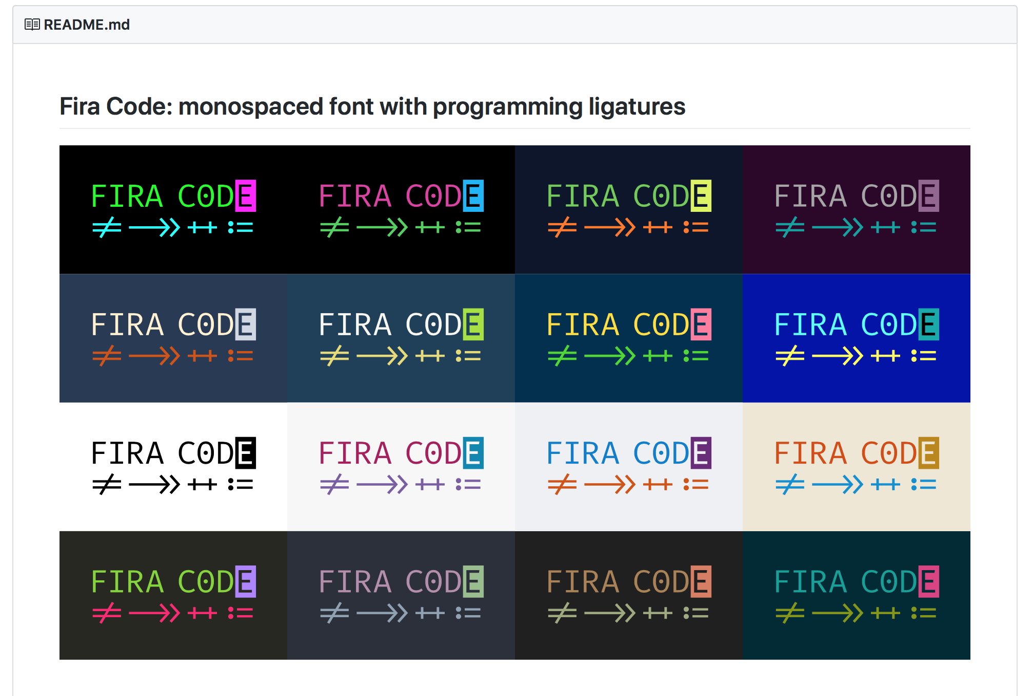
Fira Code (with ligatures)

Slide 4
Fira Code (with ligatures)
Installation
Windows
Mac
Install chocolatey first and then do
Install homebrew and then do
choco install firacode
brew tap caskroom/fonts
brew cask install font-fira-code

Slide 5
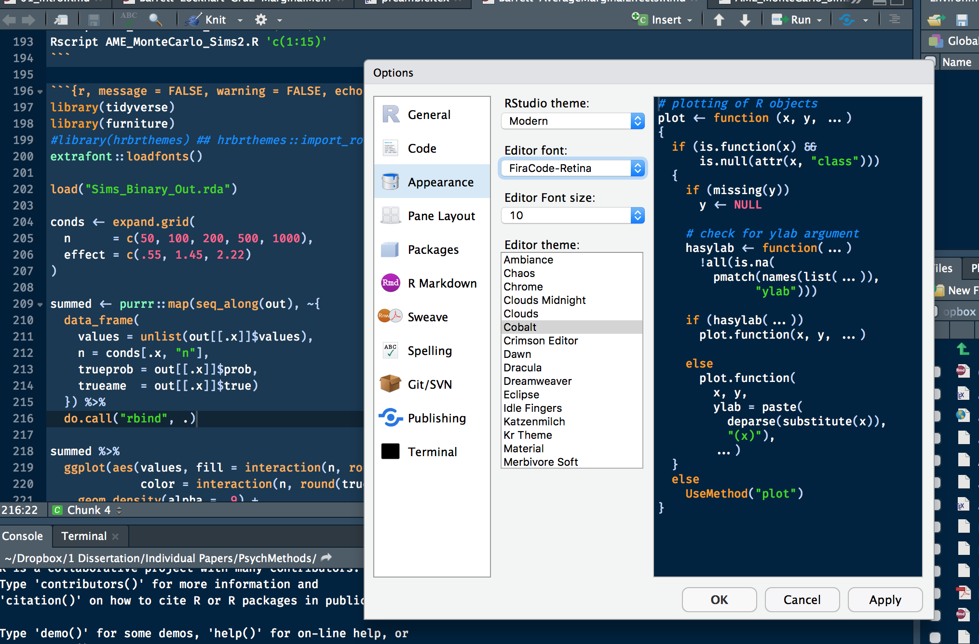
Fira Code (with ligatures)
Use It

Slide 6
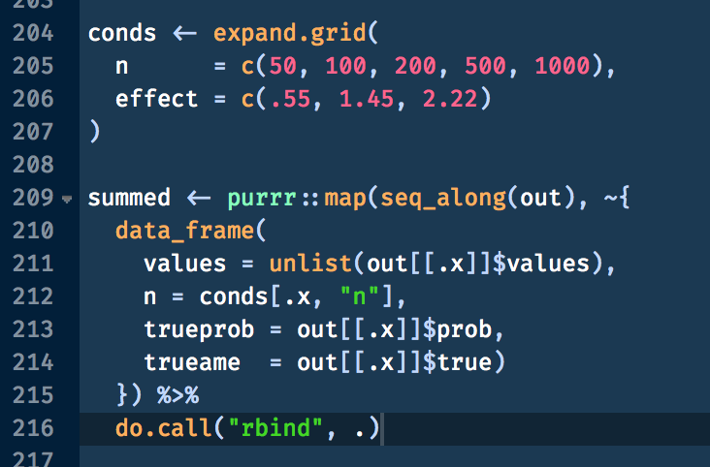
Fira Code (with ligatures)
ligatures

Slide 7
Fonts (with ligatures)
Fira Code is my favorite but there are other fonts available
This, with a good color scheme, makes writing code nicer
More options are certainly to come

Slide 8
2
Customizing ggplot2

Slide 9
HTML Colors
ggplot2 can understand HTML color codes
Allows us to use HTML colors

Slide 10
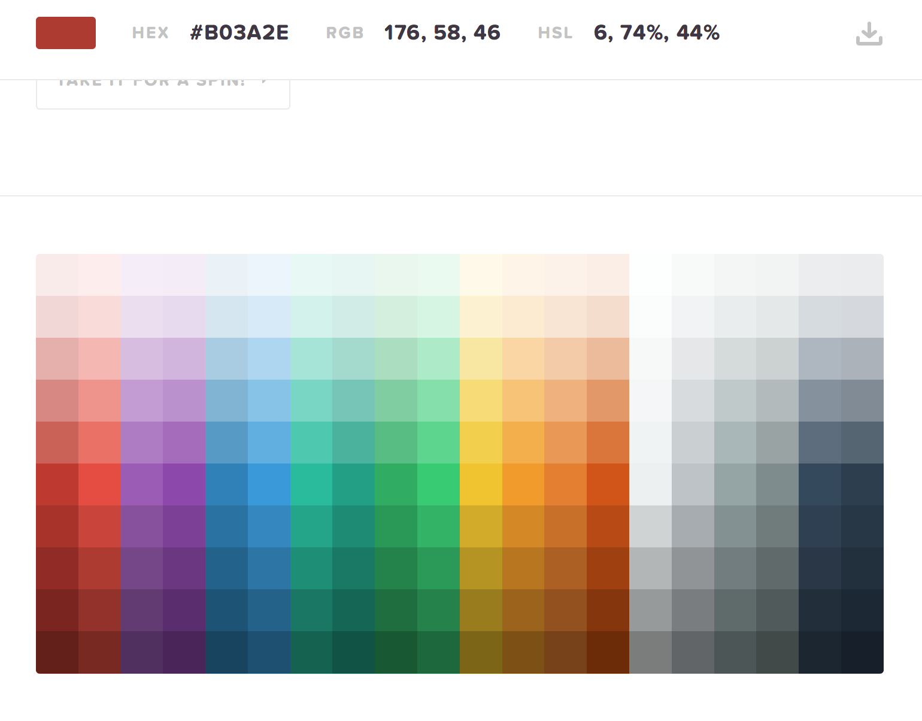
HTML Color Codes
summed %>%
ggplot(aes(x = var,
y = values,
color = group)) +
geom_point() +
facet_grid(~ third_var) +
labs(x = "Estimate", y = "Density") +
scale_color_manual(values = c("#B03A2E",
"#1F618D")

Slide 11
Other Nice Tricks
Simple Summaries
ggplot(aes(var, values)) +
stat_summary()

Slide 12
Other Nice Tricks
Patchwork
(p1 | p2) / (p3 | p4 | p5)

Slide 13
Other Nice Tricks
Patchwork
(p1 | p2) / (p3 | p4) / p5

Slide 14
Cool Animation

